Slide 1

FRONTEND DEVELOPMENT
FORSOCIAL MEDIA WEBAPP
Task – 2

Slide 2
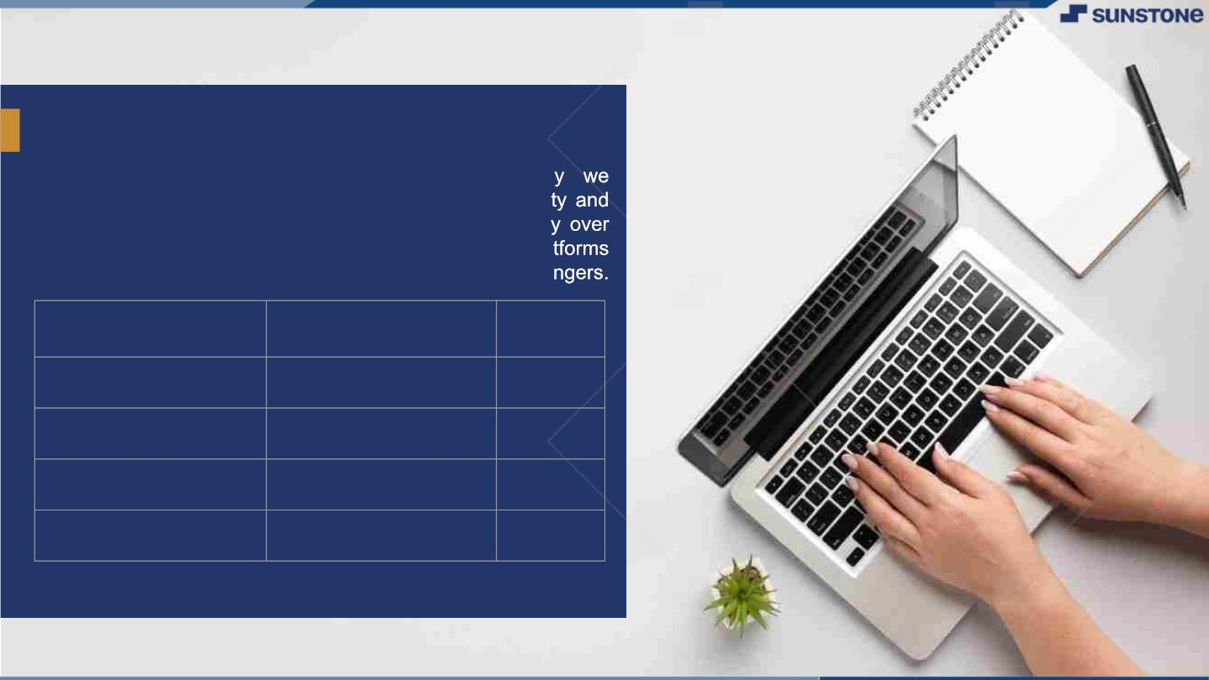
SOCIAL MEDIA WEBAPP
Social media websites have revolutionized the wa
communicate and interact with each other. The populari
usage of social media platforms have grown significantl
the past decade, with millions of people using these pla
daily to connect with friends, family, and even stra
LMS Username
2113a55306
Name
Batch
DHANUSHMATI S
JOEL JOSEPH
MADHUMITHA R
PADMAVATHI G
A55
2113a55317
A55
A55
A55
2113a55323
2113a55330

Slide 3

Task - 2
Create UI and implement various components using react
●
●
●
Split design into components and Higher order Components
Define structure of the components
Set the basic ui components with dummy data
IntegrateꢀtheꢀAPIsꢀtoꢀfrontendꢀtoꢀensureꢀtheꢀdynamicꢀfeatureꢀofꢀwebsite
●
●
●
●
●
Pointꢀbaseꢀapiꢀtoꢀtheꢀseversꢀbaseꢀurlꢀ
Designꢀapiꢀcallsꢀforꢀeachꢀelementꢀ
Handleꢀerrorsꢀinꢀtheꢀoutput
Renderꢀoutputꢀofꢀapisꢀtoꢀdifferentꢀlowꢀlevelꢀcomponents
Secureꢀcontentꢀofꢀpostꢀapisx
EvaluationꢀMetric:
● 100%ꢀCompletionꢀofꢀtheꢀaboveꢀtasks
Learning Outcome
▪
▪
▪
▪
DevelopingꢀcomplicatedꢀUIꢀusingꢀreactꢀcomponents
Usingꢀpropsꢀdrillingꢀandꢀcontextꢀtoꢀpassꢀvariables
Gettingꢀfamiliarꢀwithꢀdifferentꢀtypeꢀofꢀapiꢀcalls
Handlingꢀdifferentꢀinputꢀdata

Slide 4

Step-WiseꢀDescription
v Plan the website design: Before starting with the development of the website, you should have a clear idea of how
you want your website to look and feel.
v Choose the appropriate frontend framework: The frontend framework you choose should be scalable,
maintainable, and adaptable to the latest trends in web development.
v Develop the website layout: Start by creating the basic layout of your website, which includes the navigation bar,
header, footer, and content area.
v Design the user interface: Once you have the layout in place, you can focus on designing the user interface. This
includes creating a color scheme, typography, icons, and images that align with your website's brand and purpose.
Summaryꢀofꢀyourꢀtask
In the step-wise description, I outlined the key steps involved in creating the frontend of the website, including
planning the website design, choosing an appropriate frontend framework, developing the website layout and
functionality, implementing responsive design, testing the website, launching it, and continuously updating it to keep
it relevant and engaging.
Overall, my task involved providing a comprehensive overview of the project and outlining the steps required to
create a functional and engaging frontend for a social media website.

Slide 5

AssessmentꢀParameter
FrontendꢀforꢀSocialꢀMediaꢀ
WebApp
Setupꢀbasicꢀstructureꢀofꢀsocialꢀ
mediaꢀWebAppꢀprojectꢀ
Createꢀaꢀmainꢀcomponentꢀwithꢀtheꢀ
outerꢀstructureꢀofꢀwebsite
Check-List
Createꢀmainꢀcomponentꢀwithꢀ
allꢀfeatureꢀbuttons
Createꢀaꢀbuttonꢀcomponentꢀ
withꢀonꢀclickꢀhandler
CreateꢀaꢀCSSꢀfileꢀforꢀsocialꢀ
mediaꢀWebApp
Createꢀaꢀ`ꢀevaluateExpresion`ꢀ
functionꢀtoꢀevaluateꢀvalue
Pushꢀbothꢀcodeꢀtoꢀgithub

Slide 6
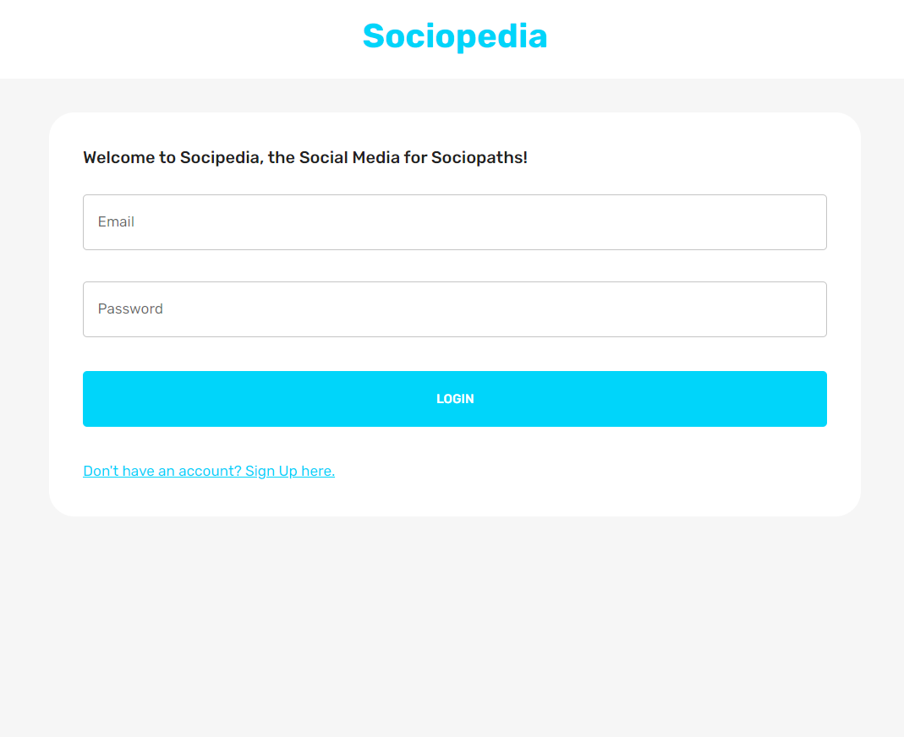
Frontend:

Slide 7

Submission Github
https://github.com/Joel449-gif/NM-
FSD/tree/main/Task%202

Slide 8


